Slide 1


24-HOUR FORECAST
28-10-2022 @ 1200 UTC
Department of Meteorology and Climate Science,
KNUST.

Slide 2
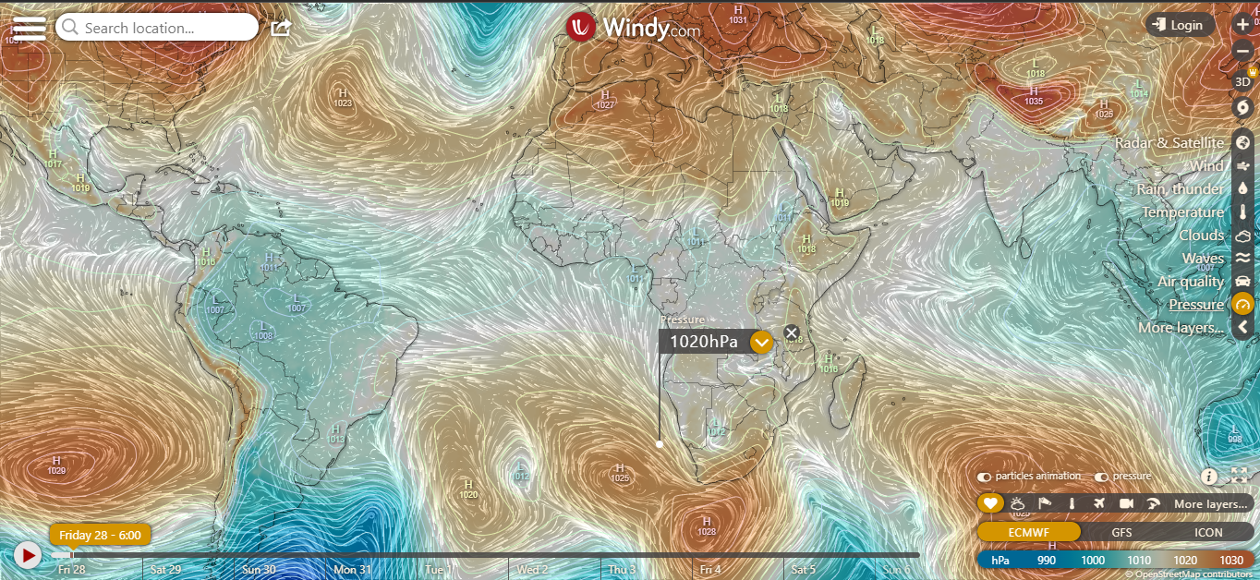
Presure System @ 0600 UTC
1023 hPa
1025hPa

Slide 3
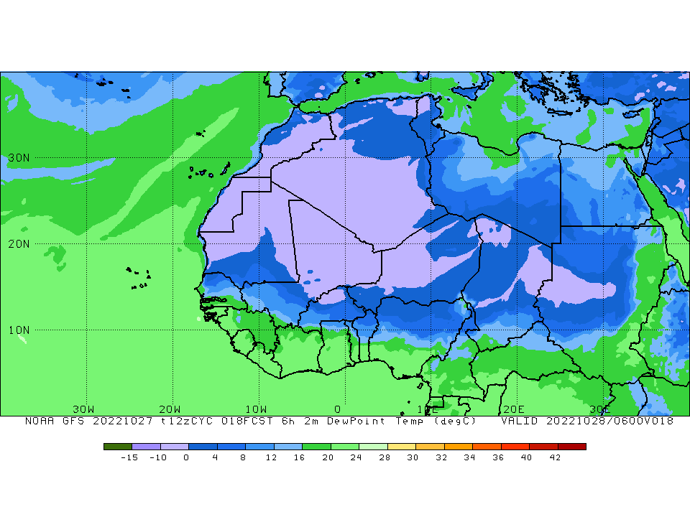

ITD POSITION @ 0600 UTC
ITD Position at 0600 UTC
$$9.9°N$$
℃

Slide 4
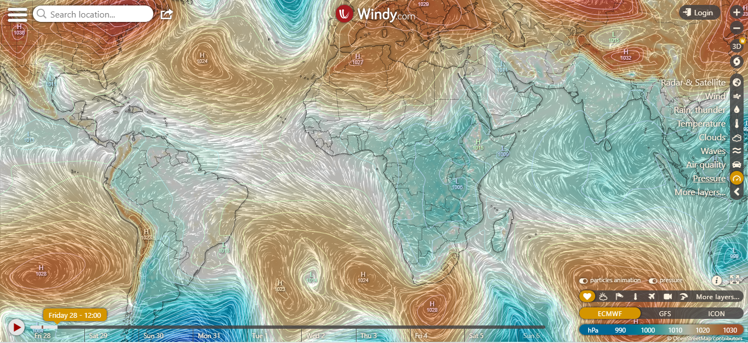
Presure System @ 1200 UTC
1024 hPa
1024 hPa

Slide 5
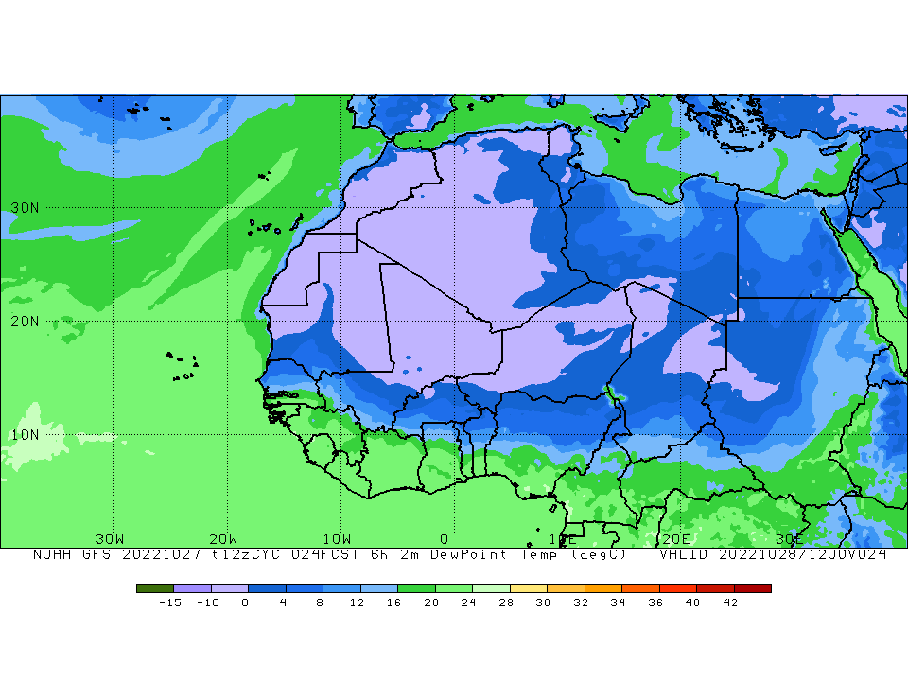
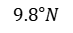
ITD POSITION @ 1200 UTC
ITD Position at 1200 UTC
$$9.8°N$$

Slide 6
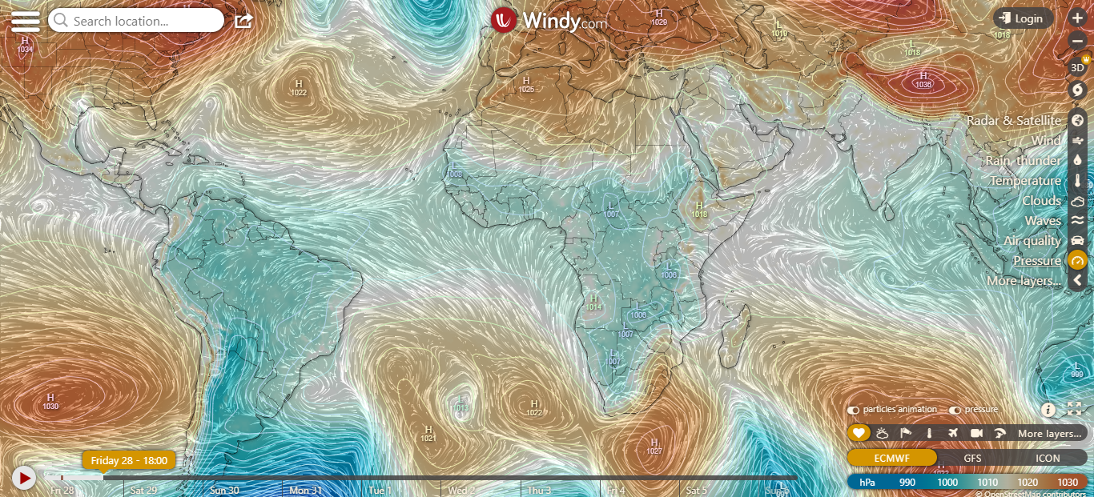
Presure System @ 1800 UTC
1022 hPa
1022 hPa

Slide 7
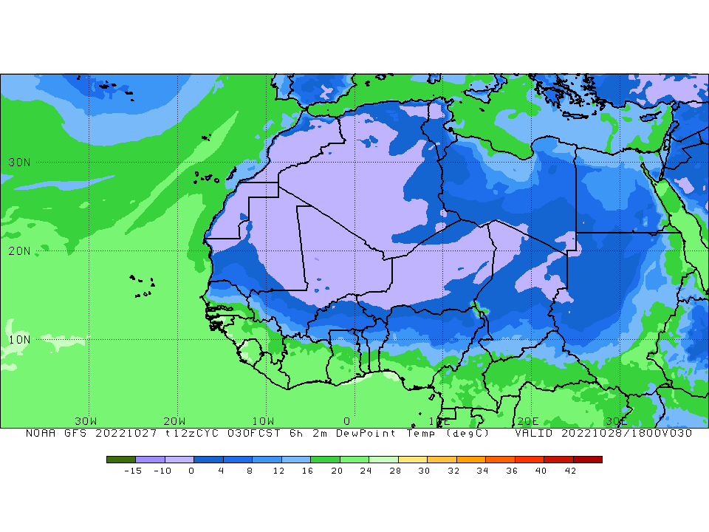

ITD @ 1800 UTC
ITD Position at 1800 UTC
$$9.8°N$$

Slide 8
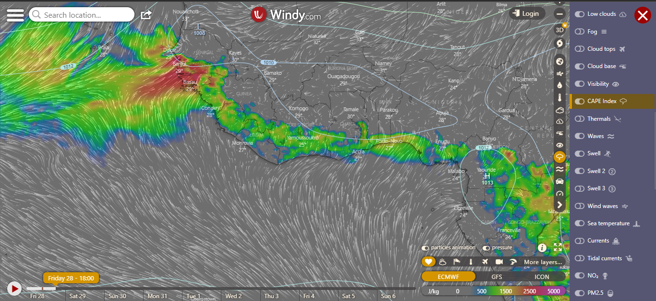
CAPE @ 1800 UTC

Slide 9
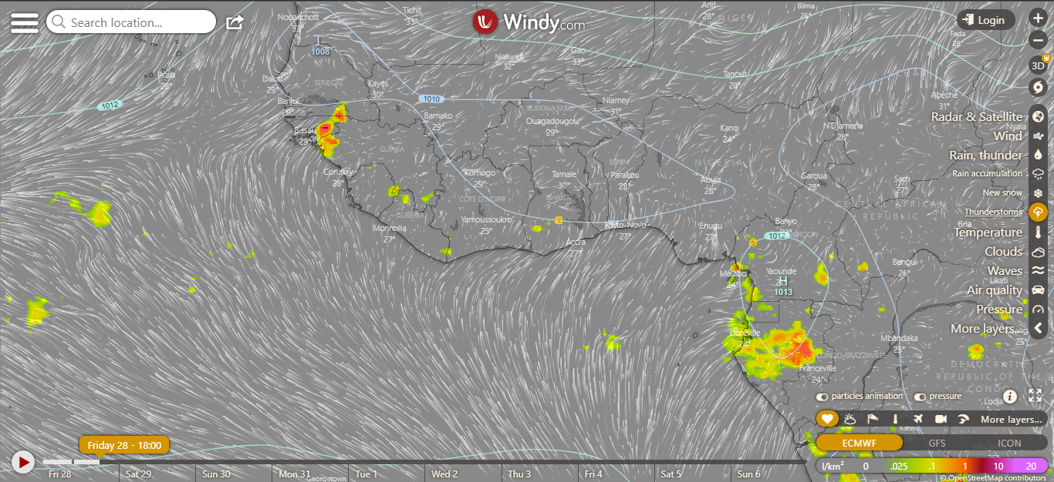
CONVECTIVE CELLS@ 1800 UTC

Slide 10
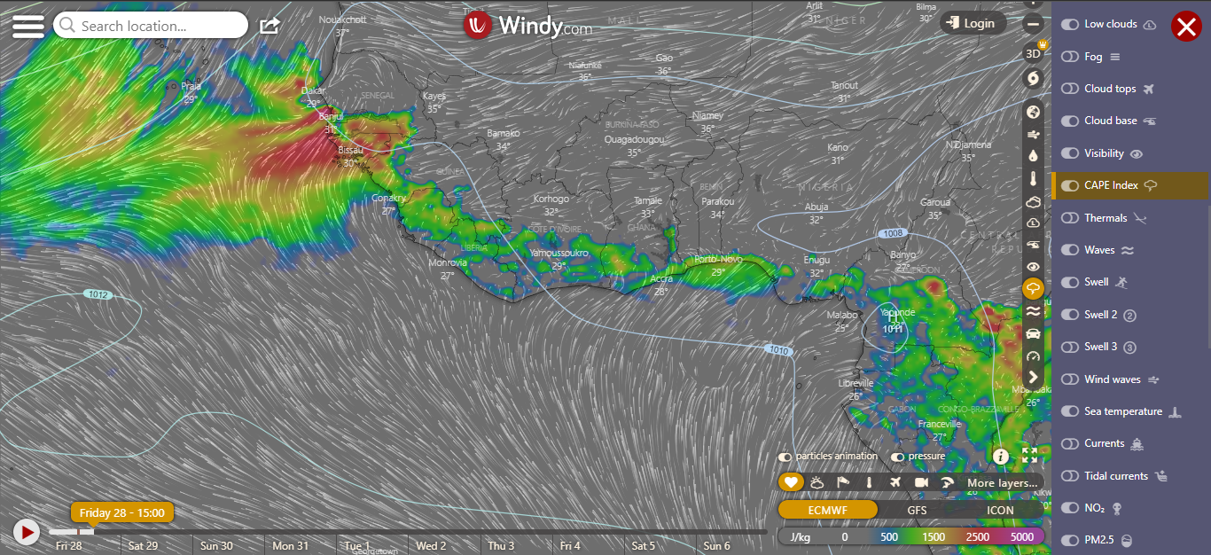
CAPE @ 1500 UTC

Slide 11
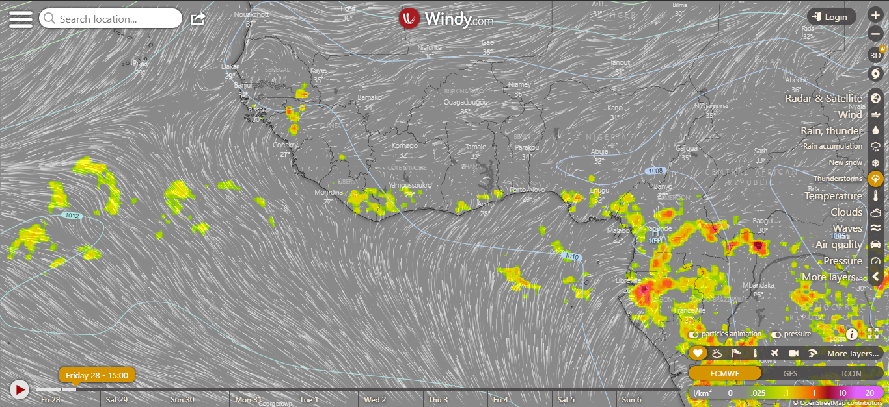
CONVECTIVE CELLS @ 1500 UTC

Slide 12
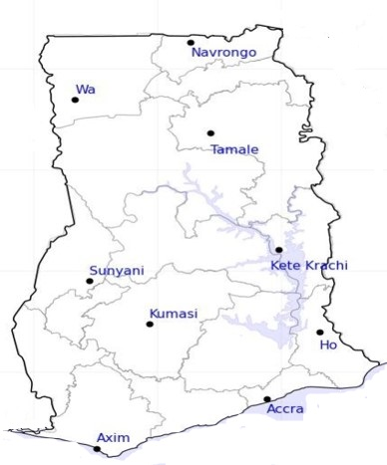
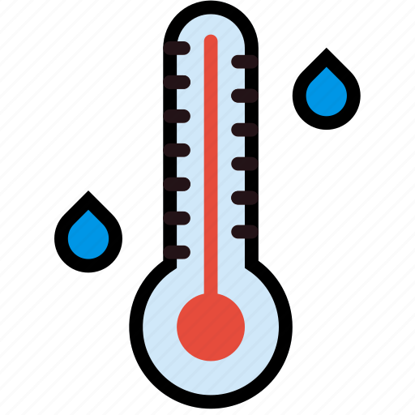
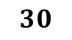
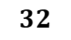
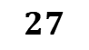
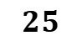
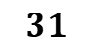
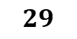
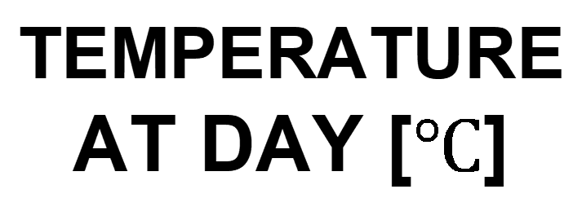
$$30$$
24-HOUR FORECAST
28-10-2022 @ 1200 UTC
$$29$$
TEMPERATURE AT DAY [$℃$]
31
30
Damango
31
$$31$$
$$32$$
$$25$$
$$27$$
$$27$$

Slide 13
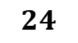
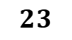
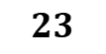
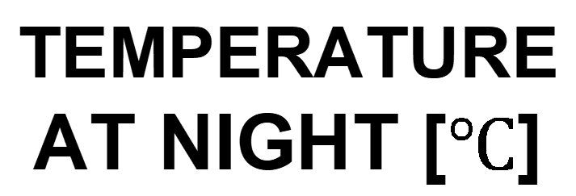
$$23$$
24-HOUR FORECAST
28-10-2022 @ 1200 UTC
$$23$$
TEMPERATURE AT NIGHT [$℃$]
$$25$$
$$24$$
Damango
$$27$$
23
$$24$$
$$23$$
$$25$$
$$25$$

Slide 14

24-HOUR FORECAST
28-10-2022 @ 1200 UTC
31
37
RH AT DAY
[%]
47
38
Damango
63
66
62
81
81
80

Slide 15
67
24-HOUR FORECAST
28-10-2022 @ 1200 UTC
58
RH AT NIGHT
[%]
70
74
Damango
85
92
97
98
96
89

Slide 16
0
24-HOUR FORECAST
28-10-2022 @ 1200 UTC
0
CAPE AT 1500
0
0
Damango
579
380
J/kg
187
694
798
365

Slide 17
0
24-HOUR FORECAST
28-10-2022 @ 1800 UTC
0
CAPE AT 1800
0
0
Damango
639
510
J/kg
1339
898
415
318

Slide 18



GENERAL OUTLOOK
24-HOUR FORECAST
28-10-2022 @ 1200 UTC
Rain
Wind
Dust
PROBABILITY OF RAINS
15-35%
Low risk
Be aware
Be Prepared
Take Action

Slide 19
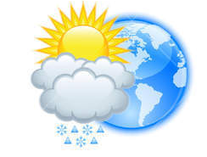




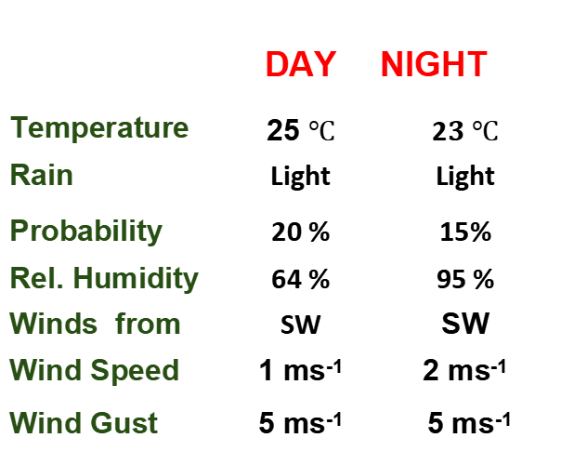
Meteorology and Climate Science
Department of Meteorology and Climate Science , KNUST
24-HOUR FORECAST
28-10-2022 @ 1200 UTC
Rain
Wind
Dust
Forecast Summary (KUMASI)
 | DAY | NIGHT
Temperature | 25 $℃$ | 2$3 ℃$
Rain | Light | Light
Probability | 20 % | 15%
Rel. Humidity | 64 % | 95 %
Winds from | SW | SW
Wind Speed | 1 ms⁻¹ | 2 ms⁻¹
Wind Gust | 5 ms⁻¹ | 5 ms⁻¹
Low risk
Be aware
Be Prepared
Take Action
SUNSET: 05:48 PM SUNRISE: 05:54 AM

Slide 20


